Slide 1
Encrypting Tunnel Data

Slide 2
Encrypted Tunneling Overview
Internet Security Association Key Management Protocol (ISAKMP) characteristics:
A framework for authentication and key exchange between two peers to establish, modify, and tear down Security Associations (SA).
ISAKMP is designed to be key exchange independent.
ISAKMP uses UDP port 500 for communication between peers.
IPsec uses Internet Key Exchange (IKE) to provide framework for the negotiation of security parameters. (IKE version 2 not covered in this course)
Internet Protocol Security (IPsec) characteristics:
A framework of open standards that is algorithm-independent.
Provides data confidentiality, data integrity, and origin authentication.
Operates by forming a Security Associations to protects and authenticates IP packets between IPsec peers.
ESP uses UDP port 50.
Notes:
Framework of standards developed by the Internet Engineering Task Force (IETF)
RFC 4301 and RFC 4309

Slide 3
IPSEC IKE version 1 Operation
IKEv1 defines two phases of key negotiation for IKE and IPsec SA establishment:
Phase 1: Establishes a bidirectional SA between two IKE peers, known as an ISAKMP SA. Because the SA is bidirectional, once it is established, either peer may initiate negotiations for phase 2.
Phase 1 has two methods for negotiation: main mode (MM) or aggressive mode (AM).
Phase 2: Establishes unidirectional IPsec SAs, leveraging the ISAKMP SA established in phase 1 for the negotiation.
The Phase 2 method used to establish the IPsec SA is known as quick mode.

Slide 4
Encrypting Tunnel Data Phase 1: ISAKMP

Slide 5
ISAKMP Policy
Internet Security Association Key Management Protocol (ISAKMP) Policy are used for IKE phase 1
HAGLE
Crypto isakmp policy X (Priority)
Hash algorithm (MD5/SHA)
Authentication method (Pre-share/RSA)
Group X (Diffie-Hellman bit #)
Lifetime of Security association (86,400 seconds by default)
Encryption algorithm (AES/DES/3DES)
*Multiple Policies can be created with weaker algorithms to be compatible with older devices.

Slide 6
ISAKMP PSK
Crypto isakmp key {passphrase} address {peer-address} [mask]
Passphrase needs to match on both sides
Peer-address needs to be the peers physical IP address
Physical IP address can be a specific host IP address (GRE) or can be a range (DMVPN)
Crypto keyring {Keyring_name} vrf {vrf_instance}
pre-shared-key address {peer-address} [mask] key {passphrase}
Crypto keyring commonly used with VRFs
Passphrase needs to match on both sides
Peer-address needs to be the peers physical IP address
Physical IP address can be a specific host IP address (GRE) or can be a range (DMVPN)

Slide 7
ISAKMP Policy and PSK Configuration Example
Crypto isakmp policy 5
Hash SHA256
Authentication pre-share
Group 19
Lifetime 86400
Encryption AES 256
Crypto isakmp key Cisco123 address 123.45.67.8
“Or for VRF”
Crypto keyring VRFKEY vrf VRFNAME
pre-shared-key address 123.45.67.0 255.255.255.0 key Cisco123

Slide 8
Encrypting Tunnel Data Phase 2: IPsec

Slide 9
IPSEC Fundamentals
IPsec Defined: A Framework of open standards for creating highly secure VPNs using various protocols and technologies for secure communications across unsecure networks.
IPsec Services:
Peer Authentication: Verifies the identity of the VPN peer through authentication
Pre-Shared Keys
Digital Certificates
Data Confidentiality: Protects data from eavesdropping attacks through encryption algorithms, (e.g. plaintext to ciphertext)
Data Encryption Standard (DES) – Deprecated Algorithm, do not use
Triple DES (3DES) – Deprecated Algorithm, do not use
Advanced Encryption Standard (AES, Rijndael) – Preferred Algorithm
Data Integrity: Protects data from man-in-the-middle attacks by ensuring the integrity of the data through hashing algorithms
Hashed Message Authentication Code (HMAC) – Utilized for authenticator key
Message Digest 5 (MD5) – Deprecated Algorithm, do not use
Secure Hash Algorithm – 1 (SHA-1) – Preferred Algorithm

Slide 10
IPSEC Transform Set
A transform set is a combination of security protocols and algorithms. During the IPsec SA negotiation, the peers agree to use a particular transform set for protecting a particular data flow.
Transform set has two Transform types:
Authentication Header (AH)
Encapsulating Security Payload (ESP)
Transform set also has two modes:
Tunnel mode
Transport mode

Slide 11
IPSEC Transform Set Transform modes
Transport Mode
Only the L3 payload is encrypted or authenticated.
Transport header is not changed.
Used for host to host communication
Tunnel Mode
L3 Data and Header are encrypted and/or authenticated.
Encapsulated with new header.
Used for network to network communication

Slide 12
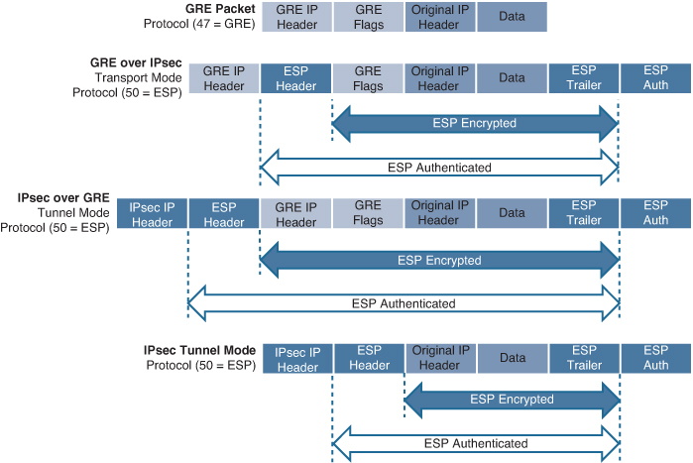
IPsec Encapsulation

Slide 13
IPsec Profile
In order to apply IPsec to a tunnel interface an IPsec profile will need to be created.
Enter the IPsec profile configuration mode by entering the command
crypto ipsec profile ipsec-profile-name
In IPsec profile configuration mode, specify the transform sets to be negotiated by using the command
set transform-set transform-set-name
Perfect Forward Secrecy (PFS) is an additional function for phase 2 that is recommended but is optional because it requires additional DH exchanges that require additional CPU cycles. The goal of this function is to create greater resistance to crypto attacks and maintain the privacy of the IPsec tunnels by deriving session keys independently of any previous key. This way, a compromised key does not compromise future keys.
set pfs group##

Slide 14
IPSEC Transform set and Profile Configuration Example
Crypto ipsec transform-set MY_TRANSFORM_SET esp-aes 256 esp-sha256-hmac
mode transport
Crypto ipsec profile MY_IPSEC_PROFILE
set transform-set MY_TRANSFORM_SET
set pfs group19

Slide 15
Apply Tunnel protection
The final step to apply IPsec it to configure IPsec protection on an interface.
Configure IPsec protection on an interface by entering the command
Interface Tunnel 1
Tunnel protection ipsec profile MY_IPSEC_PROFILE

Slide 16
IPsec Lab
Using DMVPN architecture apply the following:
crypto isakmp policy 5
encr aes 256
hash sha256
authentication pre-share
group19
Crypto isakmp key Cisco123 address xxx.xxx.xxx.xxx (Physical Network and Mask, 0.0.0.0 0.0.0.0 will cover any physical connection)
crypto ipsec transform-set MY_TRANSFORM_SET esp-aes 256 esp-sha256-hmac
mode transport
crypto ipsec profile MY_IPSEC_PROFILE
set transform-set MY_TRANSFORM_SET
set pfs group19
Interface Tunnel X
Tunnel protection ipsec profile MY_IPSEC_PROFILE

Slide 17
QUESTION
Question:
How many phases are needed to establish a IPsec tunnel?
Answer:
Two Phases
Phase 1: Establishes a bidirectional SA between two IKE peers, known as an ISAKMP SA.
Phase 2: Establishes unidirectional IPsec SAs, leveraging the ISAKMP SA established in phase 1 for the negotiation.

Slide 18
IPSEC Summary
Data can be secured by using encryption in this tunnel through the Internet and by using authentication to protect data from unauthorized access.
IPsec is a framework of open standards for creating highly secure virtual private networks (VPNs) using various protocols and technologies for secure communication across unsecure networks, such as the Internet.
IKEv1 defines two phases of key negotiation for IKE and IPsec SA establishment

